Slide 1
Apache HTTP Server

Slide 2
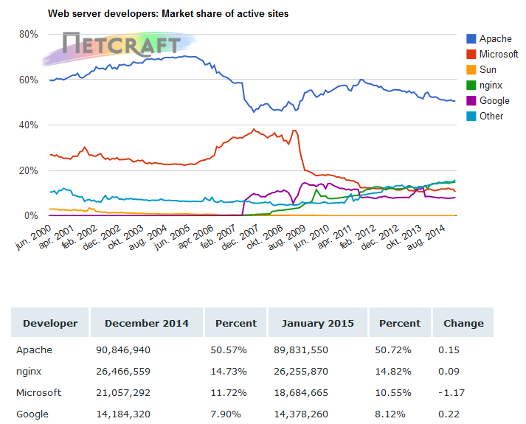
Apache HTTP Server
Commonly referred to as Apache.
http://projects.apache.org/projects/http_server.html
In 2009 it became the first web server software to surpass the 100 million website milestone.
http://news.netcraft.com/archives/2015/01/15/january-2015-web-server-survey.html

Slide 3
Apache HTTP Server
Some common language support:
Perl, Python, Tcl, and PHP
Modules
mod_access, mod_auth_basic, mod_auth_digest, mod_rewrite.
Call the function phpinfo() to see the configuration

Slide 4
Configuration
Ubuntu
/etc/apache2
apache2.conf
Directory structure
sites-*
mods-*
a2ensite, a2dissite, a2enmod, a2dismod
Since Apache 2.4, each virtual host file should have the .conf extension.

Slide 5
mod_rewrite
Modifies incoming URL requests, dynamically, based on regular expression rules
Map arbitrary URLs onto your internal URL structure in any way you like.
http://httpd.apache.org/docs/2.4/en/rewrite/

Slide 6
mod_rewrite
TestString
CondPattern
!-f: Not a file
!-d: Not a directory
RewriteEngine on
RewriteCond %{REQUEST_FILENAME} !-f
RewriteCond %{REQUEST_FILENAME} !-d
RewriteRule ^(.*)$ index.php/$1 [L]
.htaccess
(or some-
where else)
Flag
L: last
Pattern
Substitution

